Slide 1

COVID Lessons for
Agri-Food Systems Transformation
Chris Barrett
Cornell University
USAID Bureau for Resilience and Food Security Research Seminar
September 24, 2020

Slide 2
The COVID shock differs fundamentally from 2008-11 or most others
COVID and food systems
World accustomed to supply shocks to primary production or to logistics.
This, instead, is a massive:
(i) demand shock disrupting livelihoods, thus demand
(ii) food value chain shock through disruptions to (a) transport and (b) food service industries, both of which have disrupted prices/flows within distinct chains.
(but supply shock could arise from movement restrictions).
COVID both a caution and an accelerator for food systems transformation … must build back better

Slide 3
12 key lessons
So what are the key pandemic lessons for agri-food systems transformation?
A preliminary assessment of the Cornell Atkinson – Nature Sustainability expert panel on “Innovations to Build Sustainable, Equitable, Inclusive Food Value Chains”. Four HERS objectives: Healthy Diets, Equitable livelihoods, Resilient to shocks, climate/env’t Sustainability
[Caveat: we omit obvious: public health 1st order priority]

Slide 4
Stuff happens! Be ready
Key lesson #1
Not a one-off, short-run shock
Won’t be the last major challenge of our lifetimes
Prepare for more severe and more frequent shocks
Need greater resilience – incl. redundancy – in AFS

Slide 5
Need every-ready safety nets
Key lesson #2
“Starvation is the characteristic of some people not having enough food to eat. It is not the characteristic of there being not enough food to eat.” (emphasis in original) - Opening sentences, Amartya Sen, 1981 Poverty & Famines
Food systems performance is ultimately about people
today (healthy diets, equitable/inclusive livelihoods)
tomorrow (climate/env’t sustainability, resilience)
People need assurance of protection. Otherwise, high human costs, plus social solidarity/cooperation lag.
Can’t build reliable, scalable programs on the fly.

Slide 6
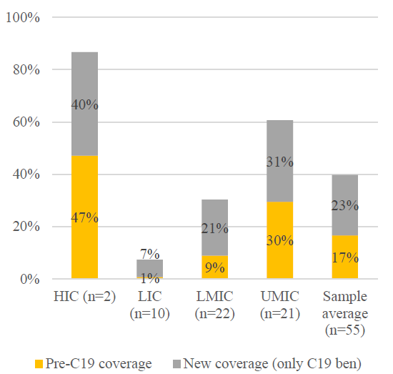
Key lesson #2
Need every-ready safety nets
Social protection upscaling has been strong, but coverage w/n LICs remains anemic. Overwhelmingly cash transfers.
Source: Gentilini et al. WB

Slide 7
Beware slower-moving shocks
Key lesson #3
Fast-moving pandemic compels policymaker attention
Beware slower moving, but equally consequential shocks: climate change, biodiversity/habitat loss, sea level rise
Slower transition too often engenders complacency
We must act now on slower-moving changes that will be equally catastrophic if we don’t prepare.

Slide 8
Beyond cost minimization
Key lesson #4
Affordable, healthy diets are important for equity. But tradeoffs w/resilience and sustainability objectives.
De-risking AFS requires greater diversification of production, sourcing, processing, and distribution patterns to enhance flexibility and redundancy.
De-risking provides costly insurance against catastrophic systemic risks

Slide 9
Beware de-globalization
Key lesson #5
Many gov’ts indulge populist instincts towards self-sufficiency in response to supply chain disruptions.
That risks environmental/climate sustainability b/c how a product is produced, processed and distributed matters far more to its env’t footprint than where it was made.
Must redouble efforts to internalize the longer-run and global externalities associated with the pursuit of short-run political gains from increased local control over AVCs

Slide 10
Fund and trust first rate science
Key lesson #6
Technical skill is essential preparation
Can adaptively manage and innovate only if we learn fast
Can’t build scientific capacity fast
But can undermine scientific capacity – and trust in science - quickly through poor communications, especially if leaders let politics trump science

Slide 11
Barriers to success more behavioral than scientific
Key lesson #7
The science has progressed at unprecedented speed
Behavioral adjustments have been slower, more uneven
Must work through social influencers and thought leaders to shift culture and policy
Need checks and balances to avoid excessive concentration of political/commercial power

Slide 12
Incentives and norms are key
Key lesson #8
AFS are decentralized systems are huge #s of actors. No grand systems optimization is feasible.
Coordinated, centralized responses are difficult at national, much less global, scale
Incentives/norms, not top-down directives, are key policy instruments. Must be clear, consistent, trusted.
Market-based, decentralized systems self-stabilized reasonably quickly and well under the circumstances.
Farm-to-fork digital markets have facilitated adjustment.

Slide 13
Communication and cooperation essential
Key lesson #9
Spillovers are ever-present
Strong coordinating institutions essential to build and maintain trust so as to quickly identify/contain contagion
Trust inevitably requires verification, so traceability is increasingly at a premium. Firms increasingly looking to traceability technologies to capture WTP for credence attributes of foods: sustainability, fairness, etc.

Slide 14
Dramatic, fast improvements are possible
Key lesson #10
Behavioral change is hard but feasible.
Rapid, sharp adjustments have happened worldwide w/ measurable results: quickly reduced GHG/ pollution emissions, sharply slowed disease transmission.
Need incentives to exert ourselves
Must develop viable C markets, PES, conservation finance

Slide 15
Treat underlying causes, not just symptoms
Key lesson #11
Pandemics are the long-predicted consequence of:
ongoing destruction of nature – more zoonoses
inconsistent, non-transparent food safety regulations
insufficient integration of food and health systems
Must de-agrarianize … actively decouple food from land. Big opportunities from CEA, precision fermentation, circular feeds, etc.
Enhance traceability through biomarkers, micro-sensors, distributed ledgers, etc.

Slide 16
Need high-frequency monitoring
Key lesson #12
Shocks to systems require near-real-time monitoring of fast-changing conditions.
Need sentinel sites for traditional survey work
Innovations in remote sensing, digital admin records, crowd-sourcing create opportunities to enable timely and cost-effective responses to systemic shocks.

Slide 17
The pandemic experience should boost innovations in several directions
Innovations implications
De-agrarianization: need to decouple food production from land to reduce anthropogenic land conversion, mitigate/adapt CC, even shorten local food supply chains.
Traceability: capture foods’ credence env’t/health attributes to internalize externalities.
Circular economy: novel feeds and fertilizers based on waste re-use show considerable potential
Social protection innovations: safety nets essential

Slide 18
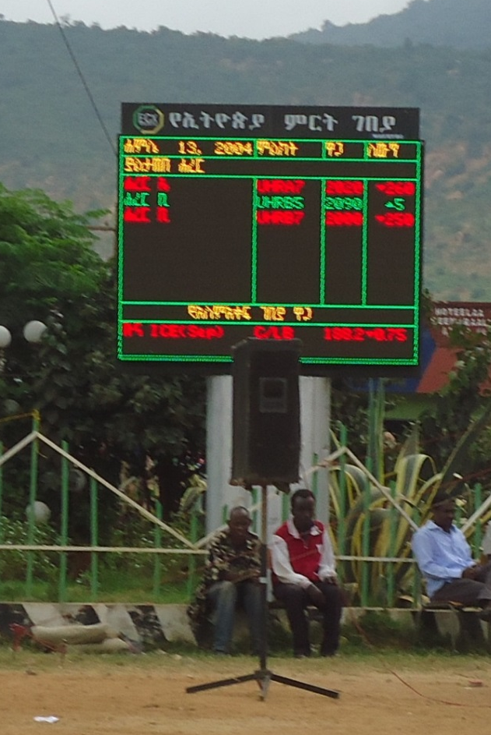
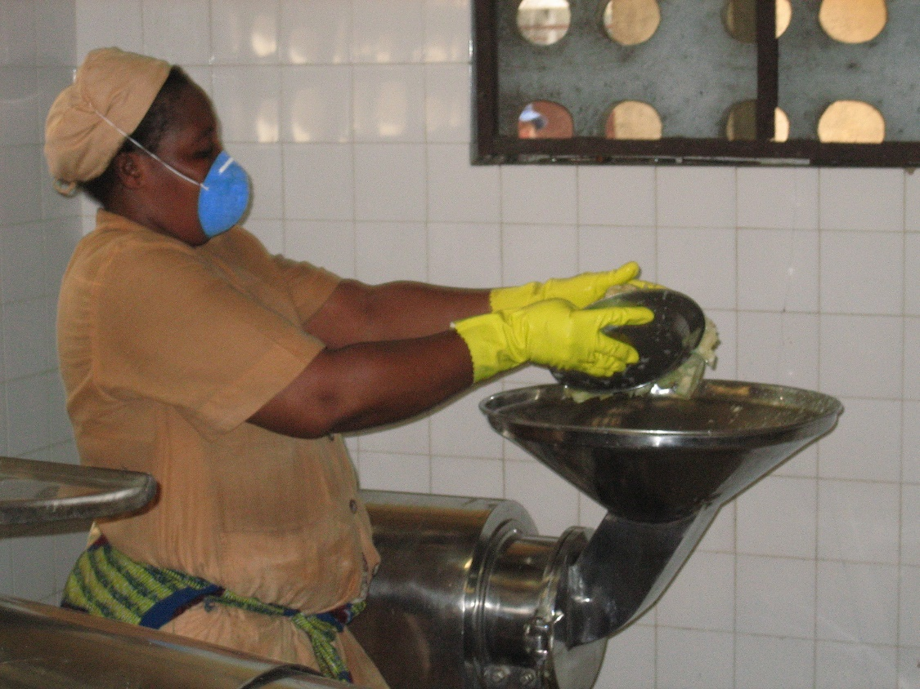
Thank you
Thank you for your interest
We invite your comments

